Slide 1
USAID-Funded Nepal Hydropower Development Project (NHDP)
REGULATORY COMPLIANCE
Training session for NEA, on preparing for regulatory oversight : Module 02 | Session 03
Rob Taylor
Chief of Party
Siddharth Mani
Regulatory Advisor
31 January 2019
This document was prepared for the United States Agency for International Development Nepal (USAID/Nepal) by Deloitte Consulting LLP on Contract No. AID-367-TO-15-00003. The contents are not the responsibility of USAID, and do not necessarily reflect the views of the United States Government.

Slide 2
Training Objectives
By the end of this session, participants should understand:
Regulatory Compliance Objectives
Compliance Obligations of the Regulated Entity
The Risks of Non-Compliance
The Importance of Information Management
Capacity Building Requirements – Regulatory Team

Slide 3
Contents
Introduction
The Regulatory Compliance Framework
Setting the Compliance Objectives
Identifying Compliance Obligations
Assessing the Risks of Non-Compliance
Performing Control Activities
Monitoring & Improvement
Need for Regulatory Department within the Utility
Why a Regulatory Department?
Objectives for establishing a Regulatory Department
Responsibilities of the Regulatory Department
Skills and Function Requirements
Case of WBSEDCL (India)
Indicative Structure of the Regulatory Team

Slide 4
Introduction

Slide 5
Introduction
Throughout the world, a better understanding of Utility Risks brings new efforts to Standardize Compliance Obligations of regulated entities. This is a good indication that regulatory activity is getting ready to pick up.
Today, most utilities under regulation are required to retrieve, compile and integrate data from multiple sources with accurate, up-to-date information on the status of their business and day-to-day operations.
Regulated suppliers will have to be prepared to rapidly adapt to operate even more effectively in an environment of increased regulation and regulatory scrutiny.
ERC is legally obligated to carry out compliance monitoring and to enforce mandatory reliability standards. In order to comply with ERC standards, utilities will need to establish a proactive compliance management process and deploy required resources to manage compliance and handle the Utility’s regulatory affairs.

Slide 6
Regulatory Compliance Framework

Slide 7
Regulatory Compliance Framework
1
Setting the Compliance Objectives
Defining appropriate compliance objectives
Identifying Compliance Obligations
Internal and external compliance events
Assessing Non-Compliance Risk
Inherent and residual risks
Performing Control Activities
Appropriate form and timeframe
Monitoring & Improvement
The compliance management process is monitored and modifications made as necessary
Setting the Compliance Objectives
Identifying Compliance Obligations
Assessing Non-Compliance Risk
Performing Control Activities
Monitoring & Improvement
5
2
4
3

Slide 8
1. Setting the Regulatory Compliance Objective
1
Full Compliance towards the reporting obligations
Timely Response towards all of the regulatory requirements
Consistent response each time
Commitment to Regulatory compliance (in terms of systems, processes and infrastructure)
Setting the Compliance Objectives
Identifying Compliance Obligations
Assessing Non-Compliance Risk
Performing Control Activities
Monitoring & Improvement
5
2
4
3
Commitment towards full compliance in a timely and consistent manner.

Slide 9
2. Identifying Compliance Obligations
1
Each compliance requirement set out in Nepali laws and ERC regulation are assessed
Their potential for the risk of non-compliance is also assessed
Regulators usually prescribe
Compliance requirements
Timelines
Penalties for non-compliance
Fees for applications
Setting the Compliance Objectives
Identifying Compliance Obligations
Assessing Non-Compliance Risk
Performing Control Activities
Monitoring & Improvement
5
2
4
3

Slide 10
2. Identifying Compliance Obligations (contd.)
Compliance Requirements – Illustration of some of the Compliance Obligations for a Utility
Tariff Related Compliance
Performance Related Compliance
Yearly Tariff Petitions (Forward Looking)
Annual Performance Review
True-up Applications
Quarterly Performance Review
Capital Expenditure Plan Approval
Grid Code Compliance
Standards of Performance
Others
Licensing Approval and Renewal
Fees and Levies

Slide 11
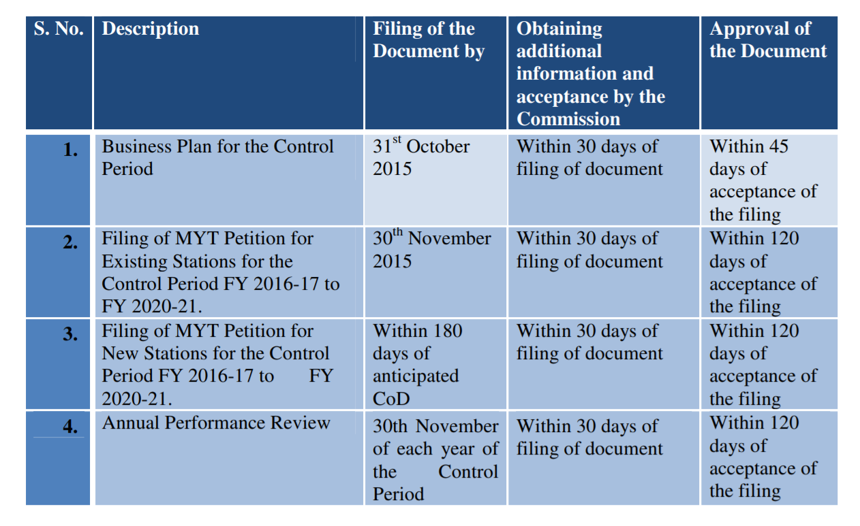
2. Identifying Compliance Obligations (contd.)
Illustrative Timeline for Compliance Requirements – Illustrative example of a timeline compliance matrix (Tariff related) prescribed by a Regulatory Commission in India

Slide 12
3. Assessing Non-Compliance Risk
1
Setting the Compliance Objectives
Identifying Compliance Obligations
Assessing Non-Compliance Risk
Performing Control Activities
Monitoring & Improvement
Assessing the impact of Inherent and residual risk violation
Most Regulatory Commissions prescribe non-compliance penalties in the form:
Monetary penalties
Suspending license
Revocation
5
2
4
3

Slide 13
3. Assessing Non-Compliance Risk (contd.)
Illustration – Penalty Clauses
Central Electricity Regulatory Commission, India
Penalties for non-compliance for Trading Licensees
Where the charge of serious contraventions is established against the licensee, the Commission may:
Direct that the licensee shall pay, by way of penalty, a sum which shall not exceed rupee one lakh for each contravention; and/or
Debar the licensee, from trading in short term market or medium term market or through power exchanges for a period not exceeding one year; or
Suspend the licence for trading in electricity for a period not exceeding one year;
or
Revoke the licence of the licensee; or
Issue such other directions or impose such other condition as the Commission may deem appropriate

Slide 14
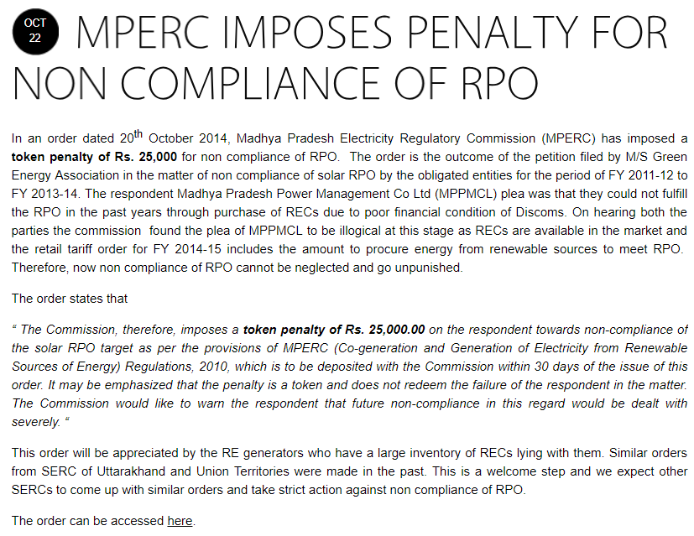
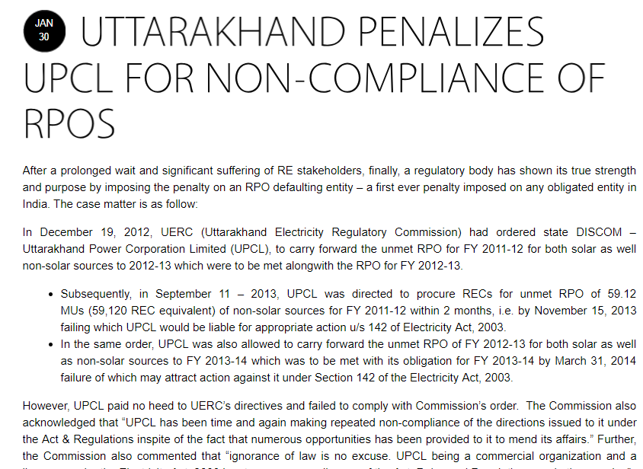
3. Assessing Non-Compliance Risk (contd.)
Illustration – Imposing Penalties
Madhya Pradesh (India) ERC penalized the State Owned Utility for non-compliance of Renewable Purchase Obligations
Uttarakhand (India) ERC penalized the Uttarakhand Power Corporation for non-compliance of Renewable Purchase Obligations

Slide 15
4. Performing Control Activities
1
Setting the Compliance Objectives
Identifying Compliance Obligations
Assessing Non-Compliance Risk
Performing Control Activities
Monitoring & Improvement
Policies and procedures established and implemented to help ensure the risk responses are effectively carried out.
Utilities should implement a Information Management Tool for compilation and communication of regulatory information (Regulatory Information Management System)
The Information Management Tool allows large volumes of compliance items to be assessed and managed
5
2
4
3

Slide 16
4. Performing Control Activities (contd.)
Drafting a Petition – Data requirements
http://jserc.org/pdf/regulations/Thermal%20Generation-MYT%20Formats.xls

Slide 17
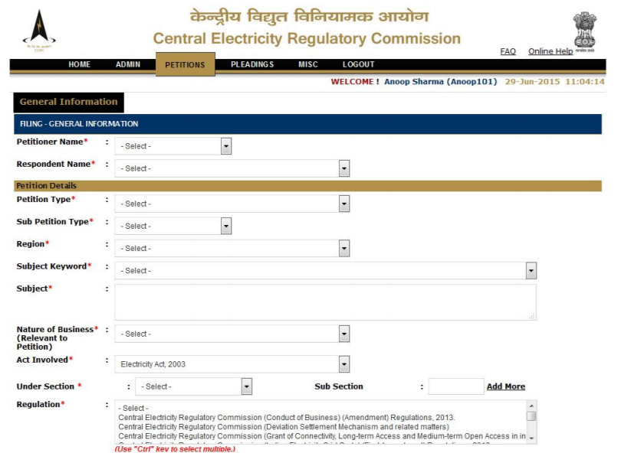
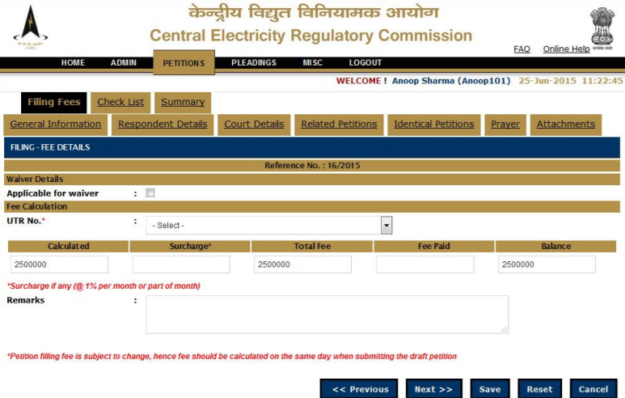
4. Performing Control Activities (contd.)
Regulatory Information Management System
A regulator might set up dedicated portals that allow regulated utilities to submit the information required by the regulator in a timely and uniform manner.
Some of the examples of online portals set up to meet the requirements of regulator include:
In India, CERC uses an e-filing portal called as System for Adjudication Using Digital Access & Management of Information through Network Integration. It allows online filing of petition, creation of diary number against the filed petition, and submission of rejoinders and replies to comments of respondents.

Slide 18
5. Monitoring and Improvement
1
Setting the Compliance Objectives
Identifying Compliance Obligations
Assessing Non-Compliance Risk
Performing Control Activities
Monitoring & Improvement
5
2
Every aspect of the compliance management program is monitored and modifications made as necessary.
Monitoring is accomplished through ongoing management activities, separate evaluations, or both.
4
3

Slide 19
Need for a Regulatory Department in the Utility

Slide 20
Why do we need a Regulatory department?
Typical Regulatory Issues encountered in Reforming Utilities
Lack of adequate ability to convince the Government, Regulators and other stakeholders. This is often due to lack of adequate infrastructure, processes and systems to provide necessary and timely information.
Weak regulatory affairs function. Generally, the regulatory affairs function in any reforming utility is either non-existent or is extremely weak. In various cases, this function is not considered as one of the key areas of the organization and thus the employees assigned to it seldom possess the relevant skills, and are even changed frequently.
Lack of ability and thrust on innovation and thought leadership. The utilities are often unable to think about new solutions to manage the problems in the sector. Again, this is the result of inadequate skills and/or focus on the regulatory affairs function.
Accordingly, managing regulatory requirements is complex, involving and a challenging task. Utilities cannot be passive followers of regulatory pronouncements but they have to play an increasingly active role in the evolution of regulation by actively communicating with the Regulator and other stakeholders.
This can be achieved only if there is a vigilant and appropriately empowered Regulatory department INSIDE THE UTILITY

Slide 21
Key Objectives and Responsibilities of a Utility Regulatory Department
Key Objectives of a Regulatory Department
To have a single channel to ensure consistency and continuity in interactions with the Regulator and the GoN;
to establish a specialist and dedicated team to monitor and manage all regulatory compliance and submissions; and
To institutionalize the arrangements for meeting the regulatory requirements in a proactive manner, including the setting up of necessary infrastructure, systems and processes.
Responsibilities of the Regulatory Department
Assist management to identify regulatory risks and possible mitigation measures
Assist management to define and implement a regulatory strategy
Monitor the orders issued by the Regulatory Commission and recommend actions on the part of the utility
Co-ordinating the compilation of submissions to the regulator, and the subsequent process of participation in regulatory proceedings
Communicate to different parts of the company the information and actions required to fulfill regulatory requirements.

Slide 22
Skills and Function Requirement
 | Industry Knowledge | Accounts / Commerce | Technical / Engineering | Finance / Economics | Legal | Business Management | Statistics
Licensing
Revenue Requirements
Tariffs
Technical Standards
Commercial Agreements
Compliance
Strategy Development
Indicates Primary Skill Requirement
Indicates Secondary Skill Requirement

Slide 23
Structure of a Regulatory Team – Case of West Bengal (India)

Slide 24
Structure of a Regulatory Team in West Bengal State Electricity Distribution Company Limited (India)
Director (Regulatory Affairs)
Chief Engineer
Regulations
AGM
Finance & Accounts and Commercial
Sr. Engineer
Technical
Sr. Manager
Legal Affairs
Functional Area | Key Responsibilities
Finance and Accounts | Various financial statements to be used for Revenue Requirements
 | Plans for the future provision of financial information in the required format where this is not currently available
 | Compliance (Payment of License Fees)
Commercial | Review the commercial information requirements of the Revenue Requirements and Tariff Filings
 | Power Purchase Agreements with Short/ Long Term Power Procurement plans
 | Bulk Supply Agreements
Technical | Operational information requirements of the licenses including various codes and standards
 | Information requirements of the Revenue Requirements and Tariff Filings
 | Load flow, Load research, systems Capacity, etc.
 | Various technical compliance issues
Legal Affairs | Critical assessment of Regulations / Policies etc.
 | Arbitration and filing cases with Appellate Tribunal

Slide 25
Thank You !
USAID’s Nepal Hydropower Development Project
Baluwatar, Kathmandu, Nepal

Slide 26
Annexure: Abbreviations
ARR | Aggregate Revenue Requirement
CAGR | Compound Annual Growth Rate
CERC | Central Electricity Regulatory Commission
DPR | Detailed Project Report
ERC | Electricity Regulatory Commission
FY | Financial Year
GDP | Gross Domestic Product
MERC | Maharashtra Electricity Regulatory Commission
MSEDCL | Maharashtra State Electricity Distribution Company Limited
MYT | Multi-Year Tariffs
NHDP | Nepal Hydropower Development Project
O&M | Operations and maintenance
PUSCL | Public Utilities Commission of Sri Lanka
PPA | Power Purchase Agreement
RoE | Return on Equity
SCADA | Supervisory Control and Data Acquisition
SAIDI | System Average Interruption Duration Index
SAIFI | System Average Interruption Frequency Index
USAID | United States Agency for International Development
WBSEDCL | West Bengal State Electricity Distribution Company Limited

